Slide 1
Which economic region in Ontario has the best opportunities for technical jobs in science?

Slide 2
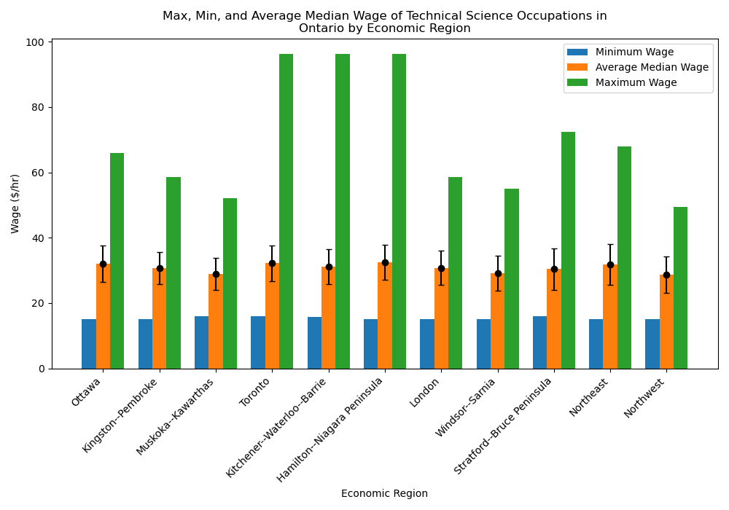
Wage Analysis
The only significant difference between economic regions is absolute maximum wage for technical occupations relating to science in Ontario.
No significant difference between average median, average min, or average max (p-value > 0.4)
Only difference is absolute maximum wage
Highest in Toronto, Kitchener, and Hamilton
May indicate highest wage growth over time in these areas
Recommendation: Start working somewhere with low cost of living, move to Toronto etc. later
Notes:
R-values > 0.4 across the board

Slide 3
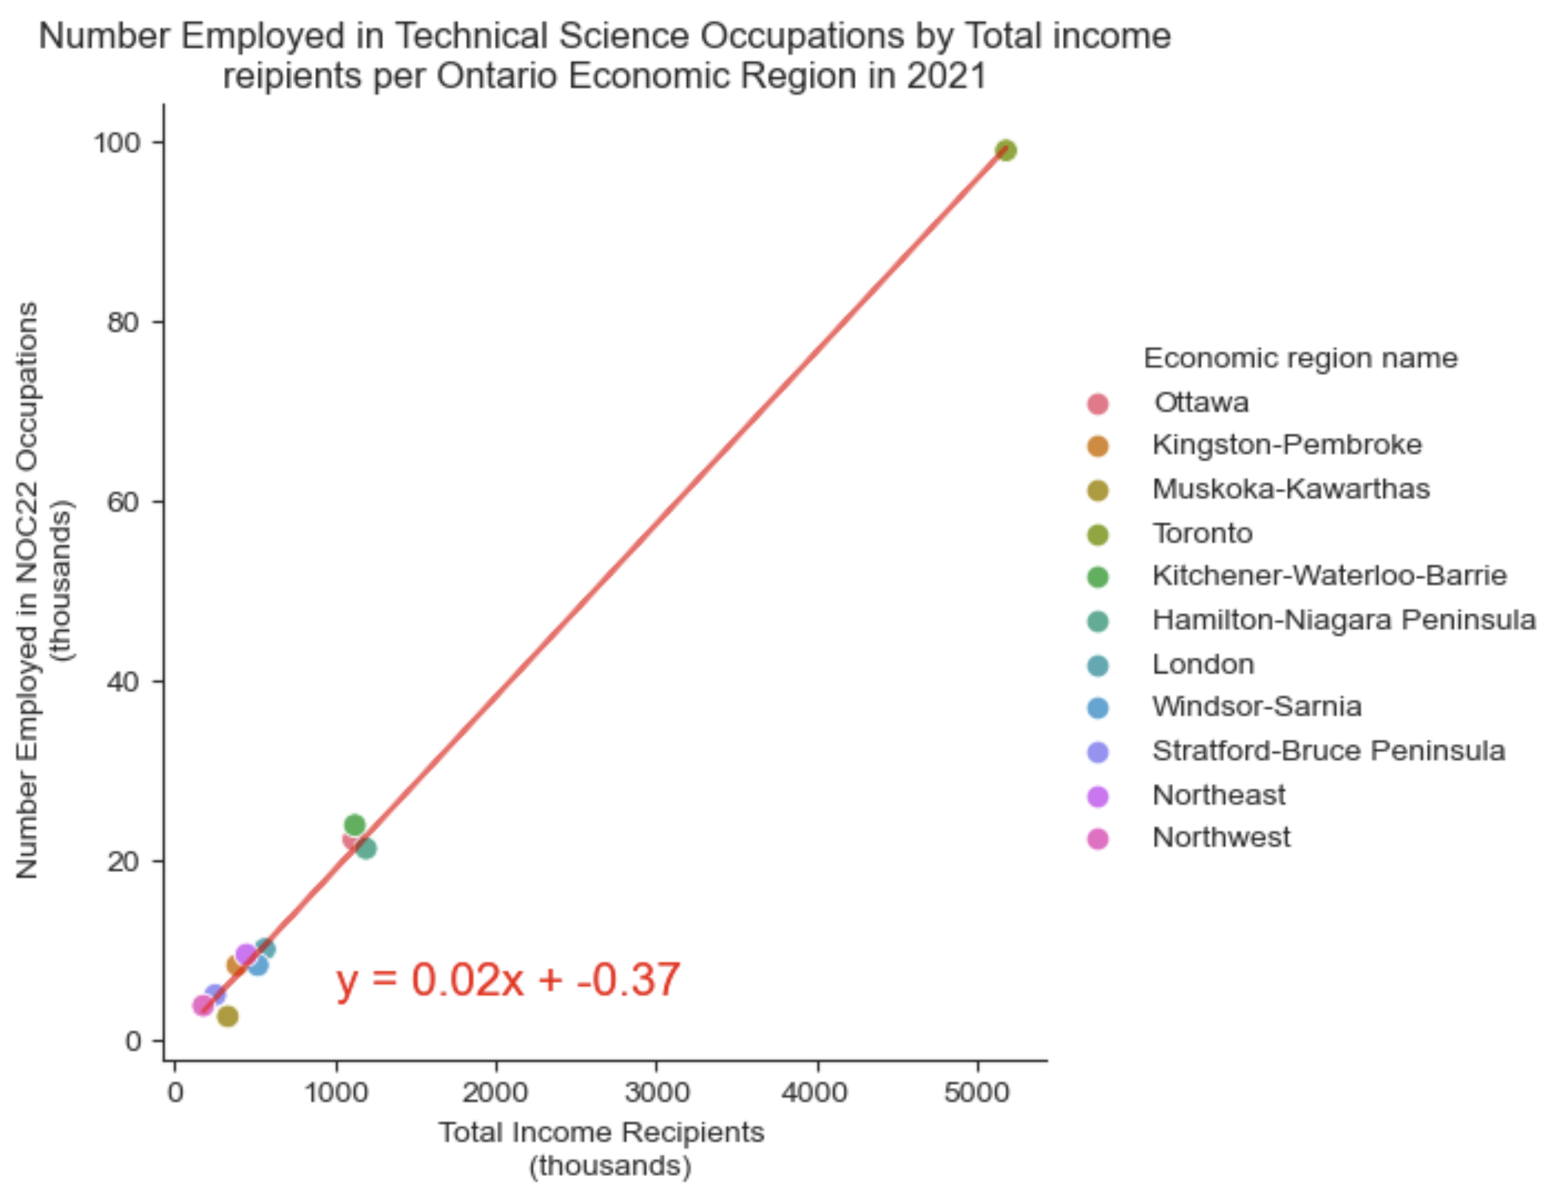
Employment Analysis
Per-capita job opportunities for individuals employed in technical science jobs is similar in all economic regions, but Toronto has the highest number of total opportunities.
Number employed in highlighted occupations correlates to total employment for each economic region
R-value = 0.998
Per-capita opportunities are similar in all economic regions
Toronto has the most job opportunities for technical science jobs
However, Toronto has a higher population so there is likely more competition for job openings
Recommendation: Look in all economic regions in Ontario for jobs, as per-capita opportunities are similar. More are likely available in Toronto however, due to its larger population

Slide 4
Job Opportunities Summary
Job opportunities are similar for individuals employed in technical science jobs in all economic regions in Ontario.
Highest wage growth in Toronto, Kitchener-Waterloo-Barrie, and Hamilton-Niagara Peninsula
Highest maximum wage for technical science jobs but no difference in minimum or average median wage
Similar number of technical science jobs per-capita in all economic regions
Highest total jobs in Toronto
Recommendation: Look in all economic regions in Ontario for jobs. Ideally start working in an area other than Toronto and move to Toronto as you increase in seniority and earning potential

Slide 5
Which economic region in Ontario has the shortest average commute and lowest cost of living?

Slide 6
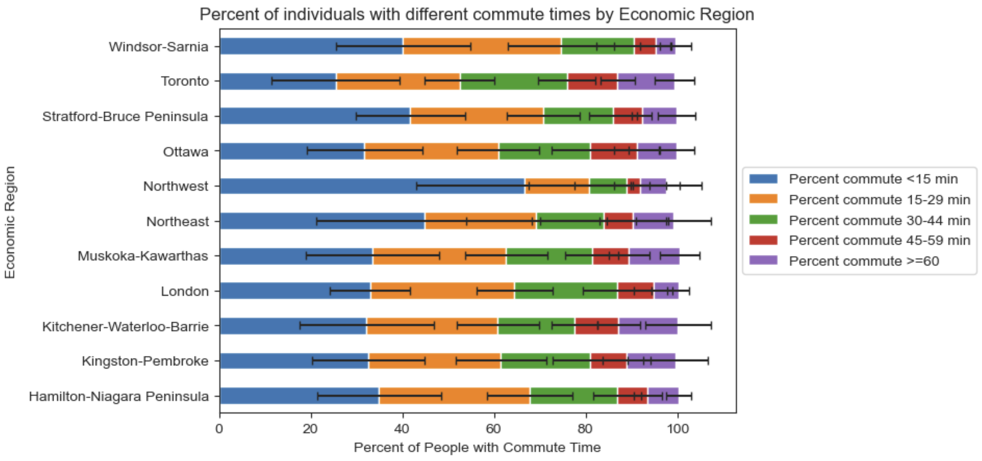
Commute Analysis
The highest percent of people with short commutes is in the Northwest economic region, and the highest percent with long commutes is in Kitchener-Waterloo-Barrie
There are significant differences in the percent of people with each commute time in each economic region
P-value < 0.001 for all bins
Economic regions Northwest, Northeast, and Stratford have the highest percent of individuals with commutes < 15 min
Economic regions Kitchener, Toronto, and Muskoka have the highest percent of individuals with commutes > 60 min
Recommendation: Based on commute alone Northwest, Northeast, and Stratford regions are best to live. Muskoka region has some of the longest commutes without the increasing job opportunities that Toronto boasts, so stay away

Slide 7
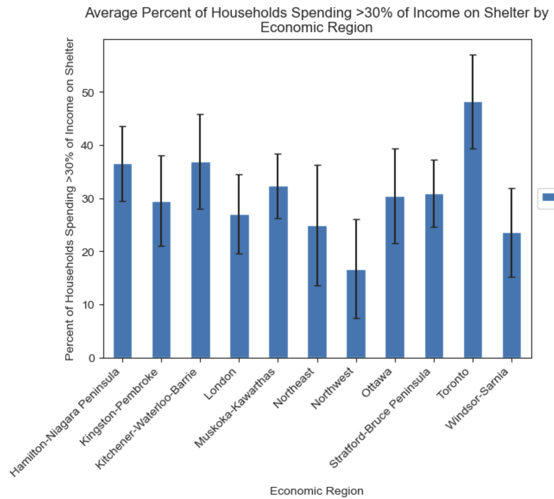
Cost of Living Analysis
The percent of households spending >30% of their income on shelter is highest in Toronto
There are significant differences in the percent of households spending >30% of income on shelter between economic regions
P-value = 2.7x10⁻³⁵
Toronto has the highest percent spending >30% of income on shelter, at 48%
This indicates that Toronto likely has the highest cost of living
Recommendation: Try not to live in Toronto, unless you can get a high wage
Percent spending >30% of income on shelter

Slide 8
Overall Summary
The Northwest economic region is the best with regards to commute and cost of living; Toronto is the worst
The wage and number of technical science jobs per capita in each economic region is similar, so this should only minimally impact choice of location at a junior level
Highest wage growth is in Toronto, Kitchener-Waterloo-Barrie, and Hamilton-Niagara Peninsula, so those with more senior roles may wish to move to these more populated city centers
Commute is longer overall in Toronto and Kitchener, and the cost of living is much higher in Toronto than in the other economic regions
The Northwest economic region has the lowest cost of living and among the shortest commute time
Recommendation: Try not to move to Toronto unless you get a high-paying job opportunity. If you can get a job in the Northwest economic region, you’re golden!

